Slide 1
William Stallings Data and Computer Communications
Chapter 10
Packet Switching

Slide 2
Principles
Circuit switching designed for voice
Resources dedicated to a particular call
Much of the time a data connection is idle
Data rate is fixed
Both ends must operate at the same rate

Slide 3
Packet Switching- Basic Operation
Data transmitted in small packets
Typically 1000 octets
Longer messages split into series of packets
Each packet contains a portion of user data plus some control info
Control info
Routing (addressing) info
Packets are received, stored briefly (buffered) and pass on to the next node
Store and forward

Slide 4
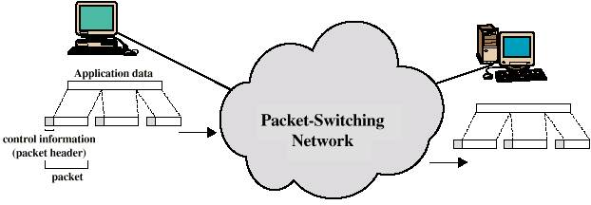
Use of Packets

Slide 5
Advantages
Line efficiency
Single node to node link can be shared by many packets over time
Packets queued and transmitted as fast as possible
Data rate conversion
Each station connects to the local node at its own speed
Nodes buffer data if required to equalize rates
Packets are accepted even when network is busy
Delivery may slow down
Priorities can be used

Slide 6
Switching Technique
Station breaks long message into packets
Packets sent one at a time to the network
Packets handled in two ways
Datagram
Virtual circuit

Slide 7
Datagram
Each packet treated independently
Packets can take any practical route
Packets may arrive out of order
Packets may go missing
Up to receiver to re-order packets and recover from missing packets

Slide 8
Virtual Circuit
Preplanned route established before any packets sent
Call request and call accept packets establish connection (handshake)
Each packet contains a virtual circuit identifier instead of destination address
No routing decisions required for each packet
Clear request to drop circuit
Not a dedicated path

Slide 9
Virtual Circuits v Datagram
Virtual circuits
Network can provide sequencing and error control
Packets are forwarded more quickly
No routing decisions to make
Less reliable
Loss of a node looses all circuits through that node
Datagram
No call setup phase
Better if few packets
More flexible
Routing can be used to avoid congested parts of the network

Slide 10
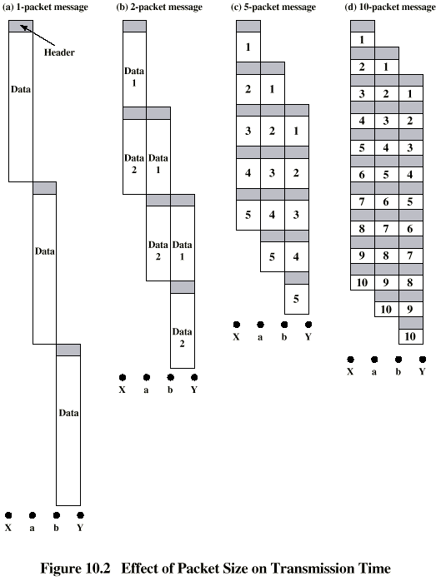
Packet Size

Slide 11
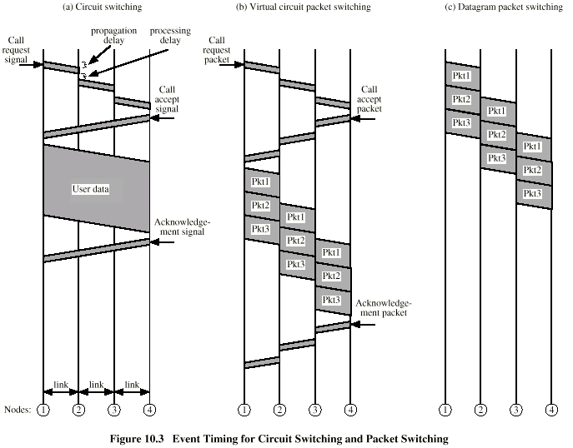
Circuit v Packet Switching
Performance
Propagation delay
Transmission time
Node delay

Slide 12
Routing
Complex, crucial aspect of packet switched networks
Characteristics required
Correctness
Simplicity
Robustness
Stability
Fairness
Optimality
Efficiency

Slide 13
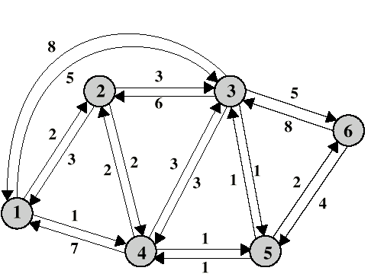
Performance Criteria
Used for selection of route
Minimum hop
Least cost
Minimum delay
Maximum throughput

Slide 14
Decision Time and Place
Time
Packet or virtual circuit basis
Place
Distributed
Made by each node
Centralized
Source

Slide 15
Network Information Source and Update Timing
Routing decisions usually based on knowledge of network (not always)
Distributed routing
Nodes use local knowledge
May collect info from adjacent nodes
May collect info from all nodes on a potential route
Central routing
Collect info from all nodes
Update timing
When is network info held by nodes updated
Fixed - never updated
Adaptive - regular updates

Slide 16
Routing Strategies
Fixed
Flooding
Random
Adaptive

Slide 17
Fixed Routing
Single permanent route for each source to destination pair
Determine routes using a least cost algorithm
Route fixed, at least until a change in network topology

Slide 18
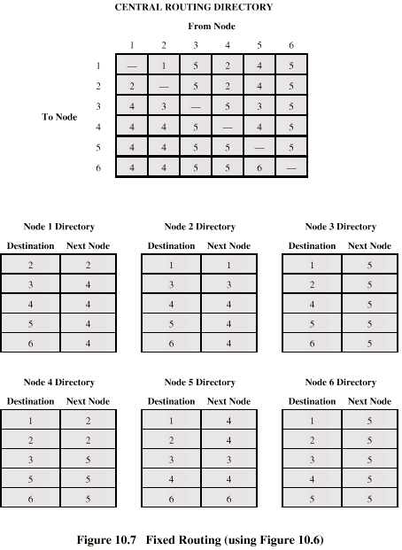
Fixed Routing Tables

Slide 19
Flooding
No network info required
Packet sent by node to every neighbor
Incoming packets retransmitted on every link except incoming link
Eventually a number of copies will arrive at destination
Each packet is uniquely numbered so duplicates can be discarded
Nodes can remember packets already forwarded to keep network load in bounds
Can include a hop count in packets

Slide 20
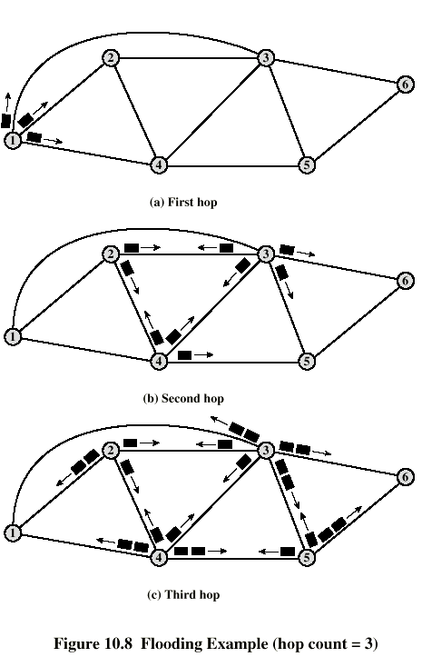
Flooding Example

Slide 21
Properties of Flooding
All possible routes are tried
Very robust
At least one packet will have taken minimum hop count route
Can be used to set up virtual circuit
All nodes are visited
Useful to distribute information (e.g. routing)

Slide 22
Random Routing
Node selects one outgoing path for retransmission of incoming packet
Selection can be random or round robin
Can select outgoing path based on probability calculation
No network info needed
Route is typically not least cost nor minimum hop

Slide 23
Adaptive Routing
Used by almost all packet switching networks
Routing decisions change as conditions on the network change
Failure
Congestion
Requires info about network
Decisions more complex
Tradeoff between quality of network info and overhead
Reacting too quickly can cause oscillation

Slide 24
Adaptive Routing - Advantages
Improved performance
Aid congestion control
Complex system
May not realize theoretical benefits

Slide 25
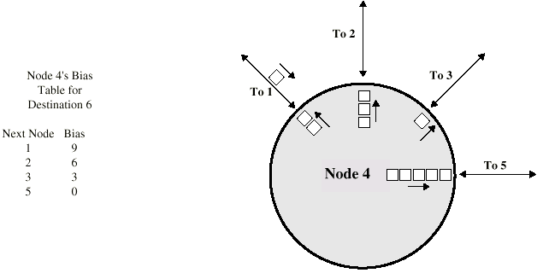
Adaptive Routing - Classification
Based on information sources
Local (isolated)
Route to outgoing link with shortest queue
Can include bias for each destination
Rarely used - do not make use of easily available info
Adjacent nodes
All nodes

Slide 26
Quiz – Not This Week
Quiz – make a client
Connect to the server( daum.net, port=80)
Send the message “Test.\n\n” and Print all messages
Connected to server ...
Thread start...
SND 8> Test.
Server Connection Closed !
RECV 124> 127 bytes: <!DOCTYPE HTML PUBLIC "-//IETF//DTD HTML 2.0//EN">
<html><head>
<title>302 Found</title>
</head><body>
<h1>Found</h1>
<p>The do儆儆?陷즶?j3v|
RECV 124> 99 bytes: cument has moved <a href="http://status.daum.net/error/error
403.html">here</a>.</p>
</body></html>
dy>
<h1>Found</h1>
<p>The do儆儆?陷즶?j3v|

